Slide 1

PROJECT
E-COMMERCE

Slide 2
E-COMMERCE
E-commerce (electronic commerce) is the activity of electronically buying or selling of products on online services or over the Internet. E-commerce draws on technologies such as mobile commerce, electronic funds transfer, supply chain management, Internet marketing, online transaction processing, electronic data interchange (EDI), inventory management systems, and automated data collection systems.
E-commerce is in turn driven by the technological advances of the semiconductor industry, and is the largest sector of the electronics industry.

Slide 3
LEARNING OBJECTIVES:
Explain the process that should be followed in building an e-commerce Web site
Describe the major issues surrounding the decision to outsource development and/or hosting
Identify and understand the major considerations involved in choosing server and e-commerce merchant server software
Identify additional tools that can improve Web site performance

Slide 4
BUILDING AN E-COMMERCE SITE: A SYSTEMATIC APPROACH
Two most important management challenges in building a successful e-commerce site are:
Developing a clear understanding of business objectives
Knowing how to choose the right technology to achieve those objectives

Slide 5
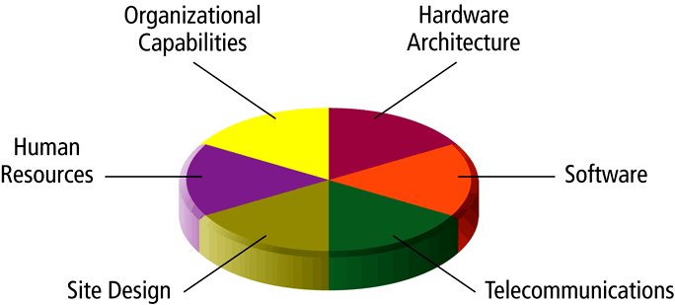
PIECES OF THE SITE-BUILDING PUZZLE
Main areas where you will need to make decisions in building a site include:
Human resources and organizational capabilities—creating a team that has the skill set to build and manage a successful site
Hardware
Software
Telecommunications
Site design

Slide 6
THE SYSTEMS DEVELOPMENT LIFE CYCLE
Systems Development Life Cycle (SDLC) is a methodology for understanding the business objectives of a system and designing an appropriate solution
Five major steps in the SDLC are:
Systems analysis/planning
Systems design
Building the system
Testing
Implementation

Slide 7
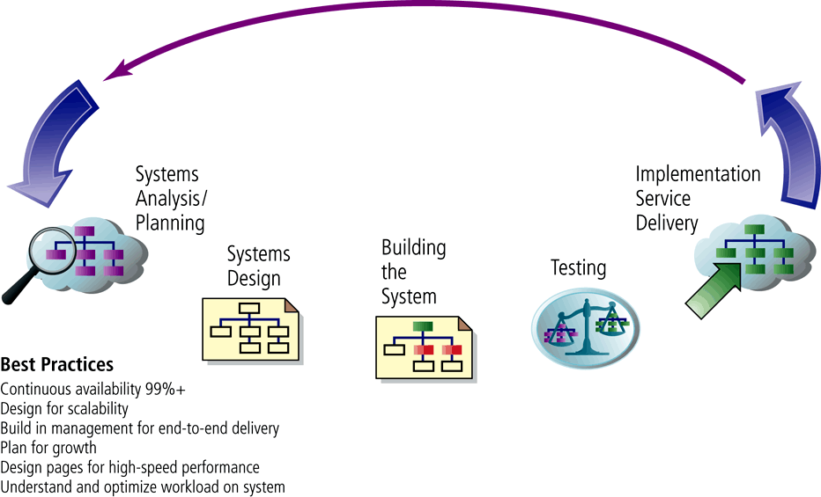
WEB SITE SYSTEMS DEVELOPMENT LIFE CYCLE

Slide 8
TESTING, IMPLEMENTATION, AND MAINTENANCE
Testing: Includes unit testing, system testing, and acceptance testing
Implementation and maintenance:
Maintenance is ongoing
Benchmarking: process by which site is compared to those of competitors in terms of response speed, quality of layout, and design

Slide 9
PROJECT USER INTERFACE

Slide 10
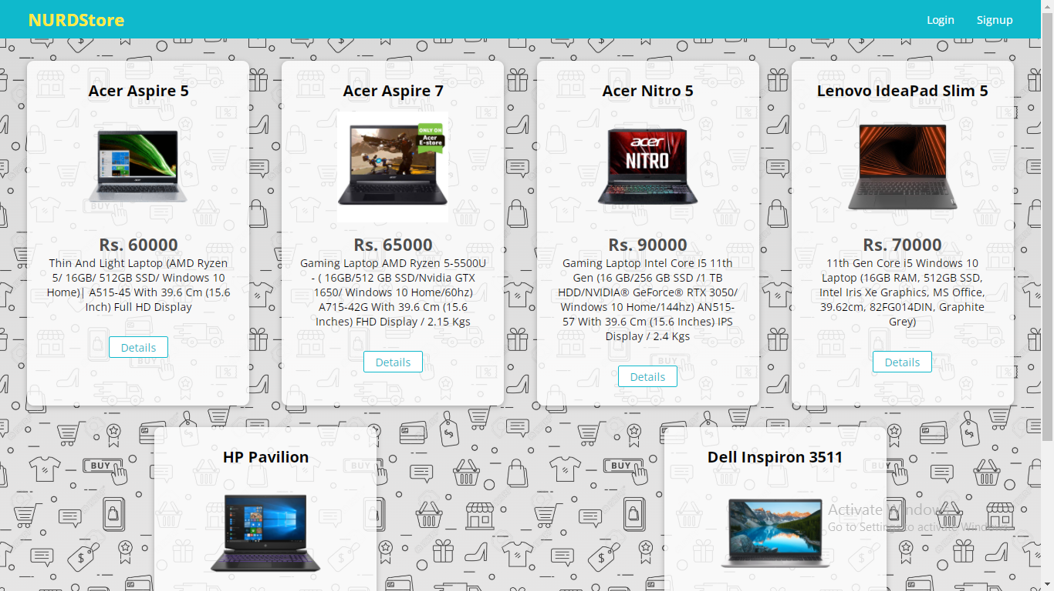
HOME PAGE

Slide 11
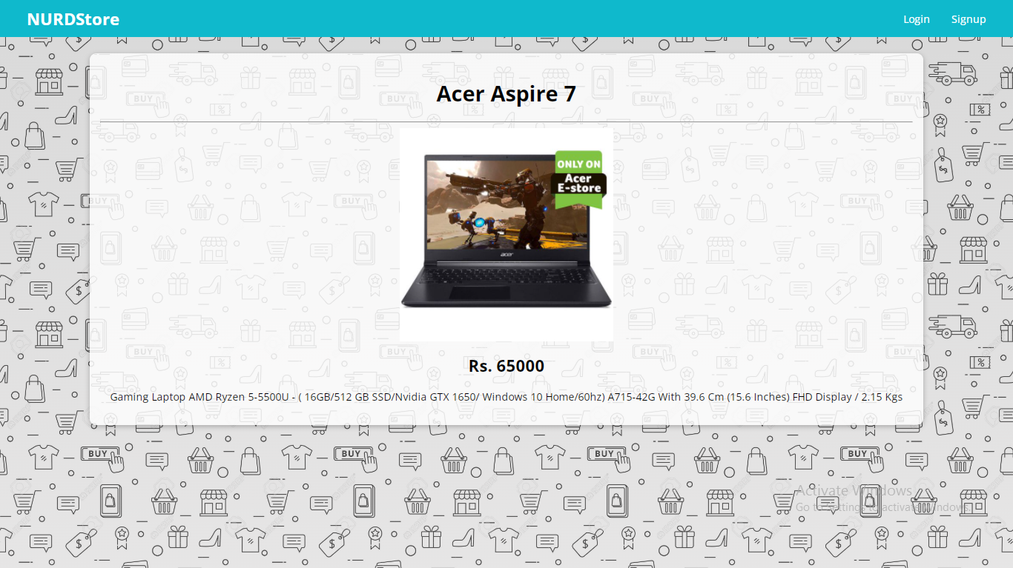
HOME PRODUCT DETAILS(NOT AUTH)

Slide 12
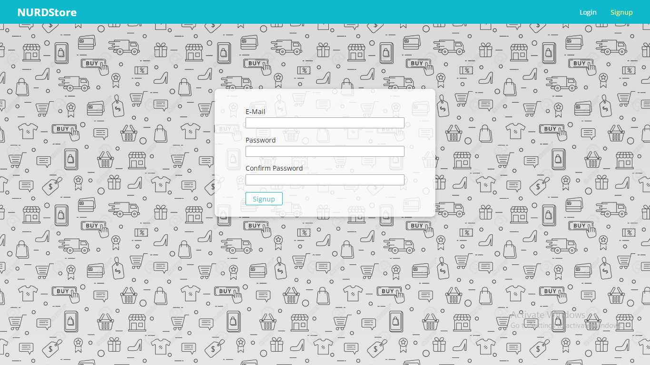
SIGN-UP

Slide 13
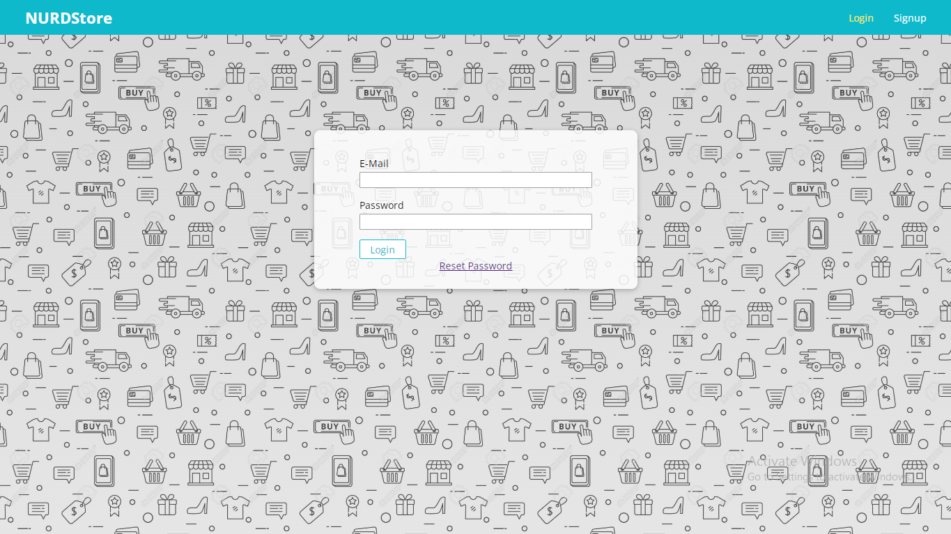
LOGIN PAGE

Slide 14
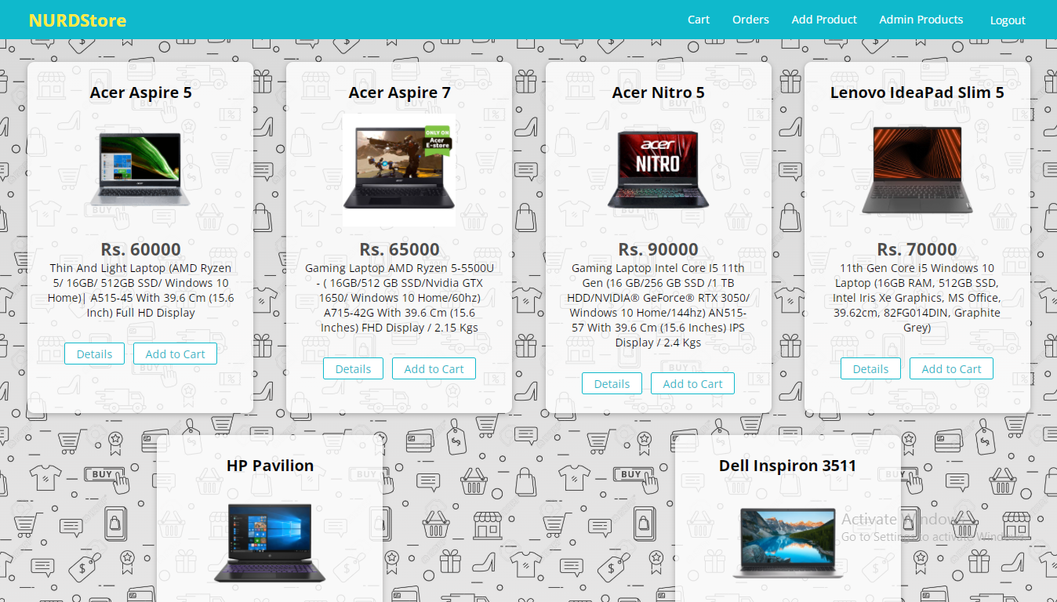
USER HOME PAGE

Slide 15
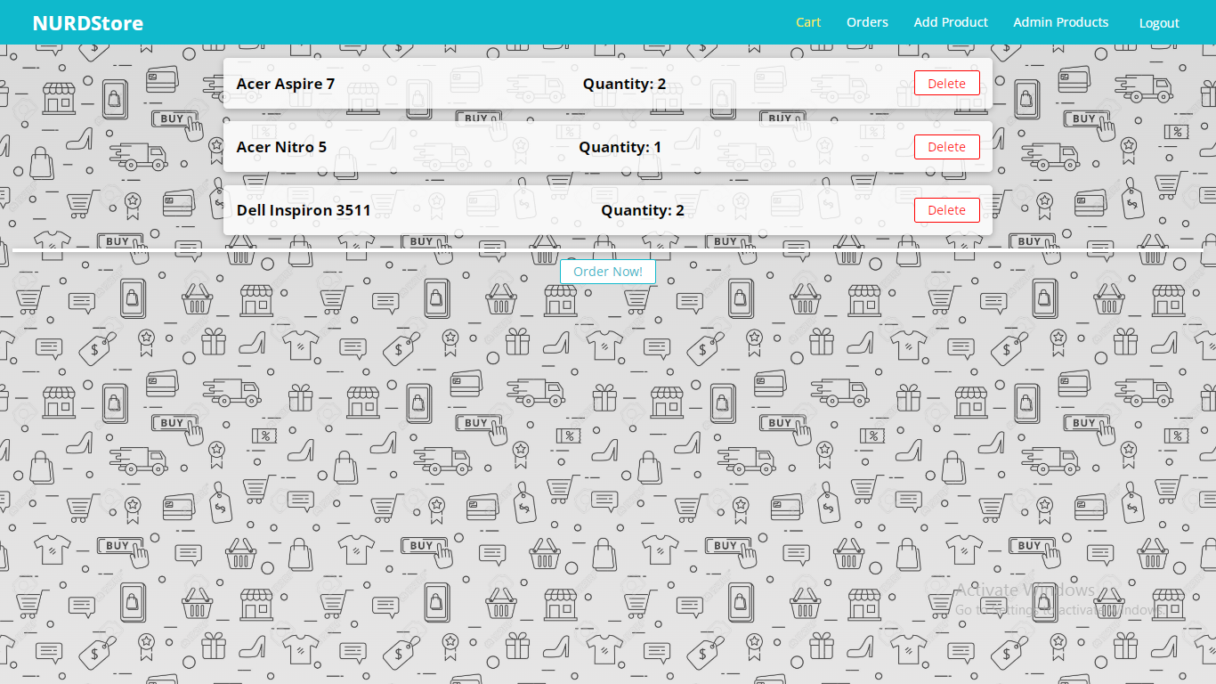
USER CART PAGE

Slide 16
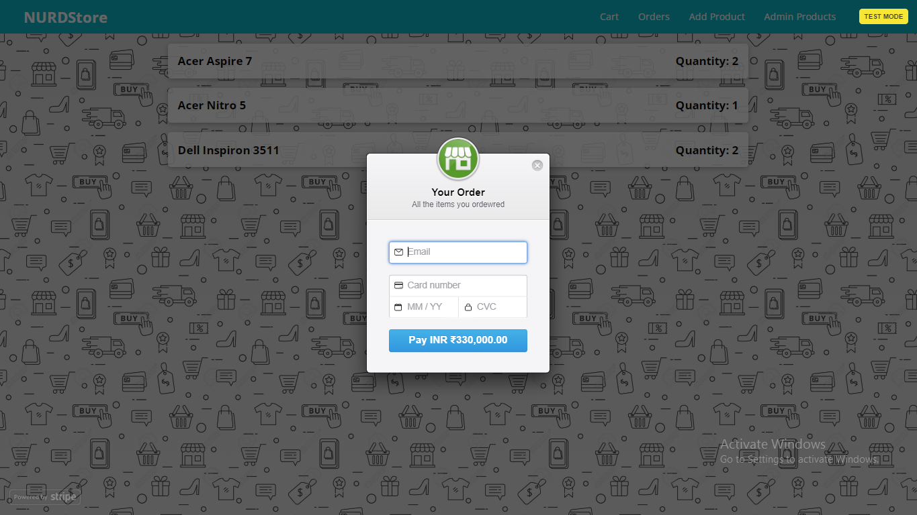
USER PAYMENT GATEWAY PAGE

Slide 17
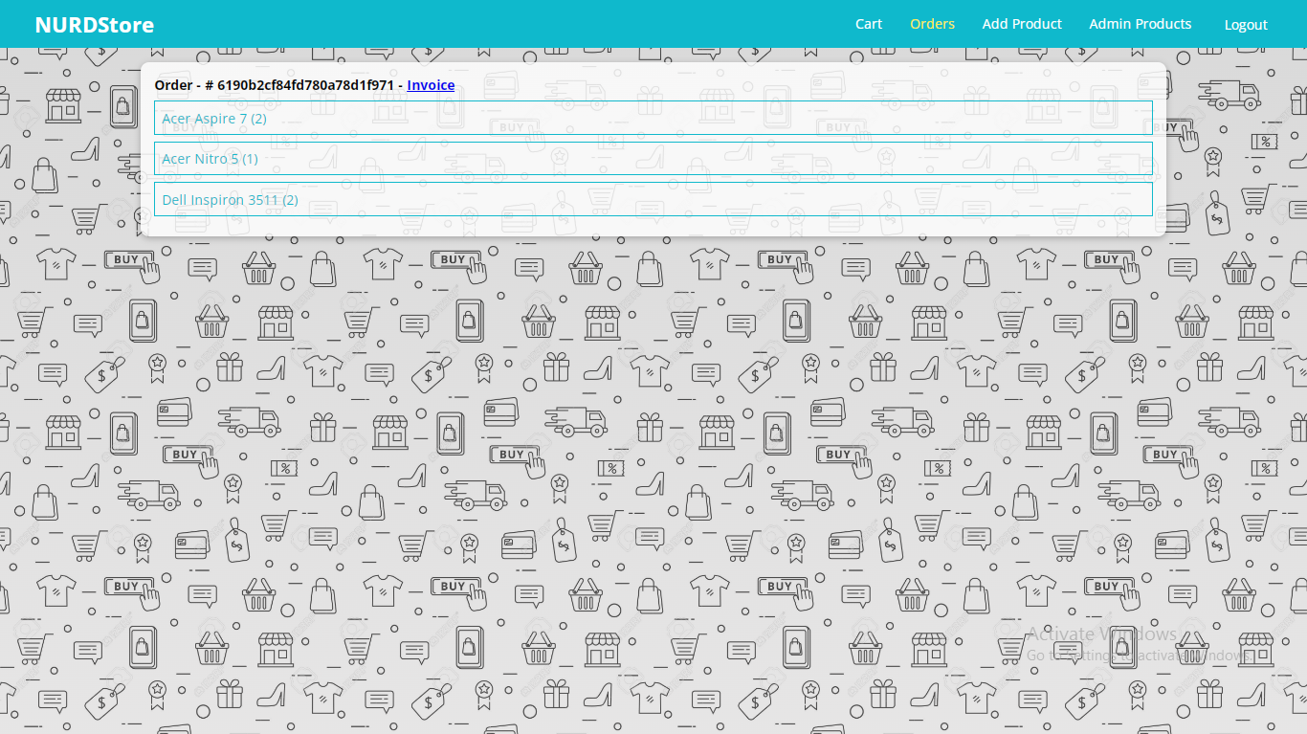
USER ORDERS PAGE

Slide 18
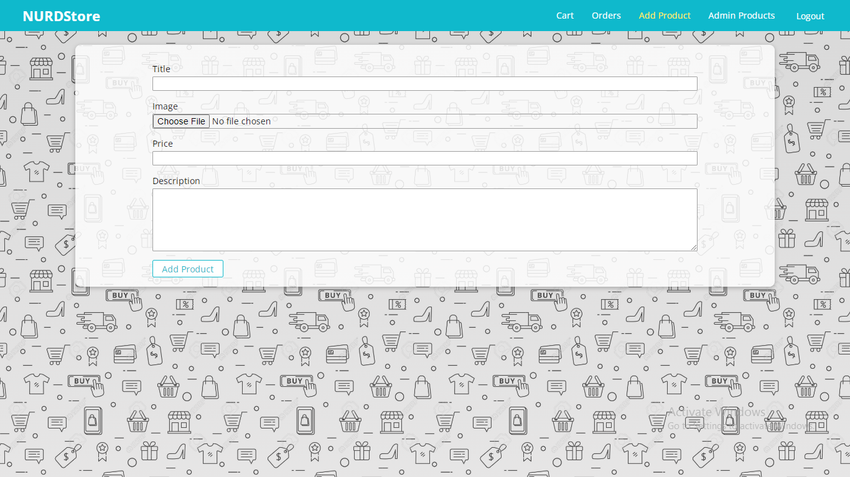
USER ADD PRODUCT PAGE

Slide 19
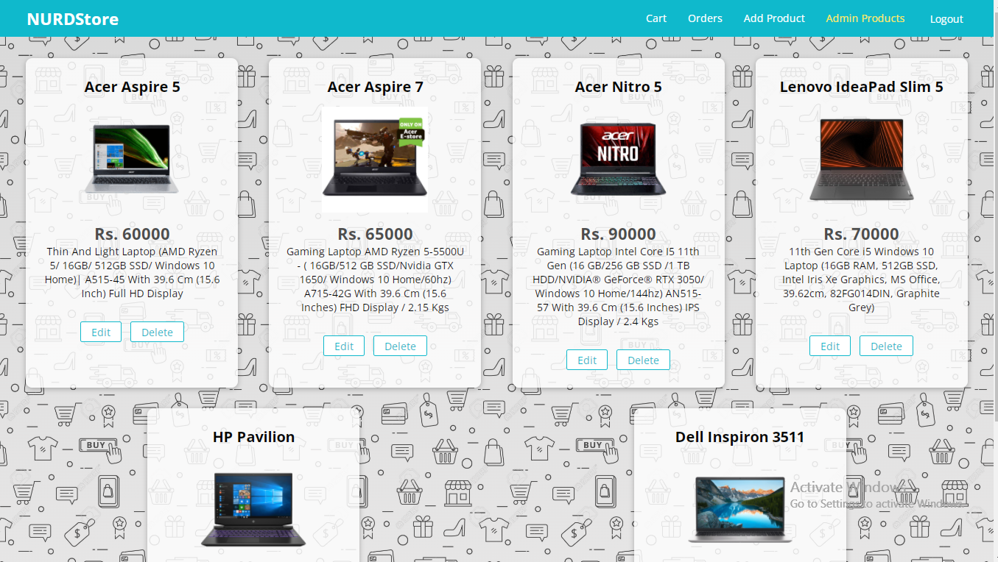
USER ADMIN PRODUCT PAGE

Slide 20
THANK YOU

